Slide 1
Interrupt
Yubin Xia
IPADS, SJTU
ACKs: Some slides are adapted from the textbook’s original slides and Frans’s os course notes

Slide 2
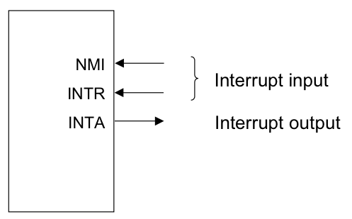
Review: Events causing User->Kernel
Device interrupt: external
Nonmaskable interrupt (NMI) input pin
Interrupt (INTR) input pin
Software interrupt: execution of the Interrupt instruction
e.g., INT
Program faults: If some error condition occur by the execution of an instruction. E.g.,
divide-by-zero interrupt

Slide 3
Review: OS as Services
Exception
Application (CPU)
Exception
Table
OS
Services
I/O Device
Interrupt
Notes:
Question: what if

Slide 4
Review: Terminology for Intel
Interrupts (asynchronous, device generated)
Maskable: device-generated, associated with IRQs (interrupt request lines); may be temporarily disabled (still pending)
Nonmaskable: some critical hardware failures
Exceptions (synchronous, from software)
Processor-detected
Faults – correctable (restartable); e.g. page fault
Traps – no reexecution needed; e.g. breakpoint
Aborts – severe error; process usually terminated (by signal)
Programmed exceptions (software interrupts)
int (system call), int3 (breakpoint)
into (overflow), bounds (address check)

Slide 5
Putting It All Together
Memory Bus
IRQs
0
PIC
(8259A)
CPU
IDTR
INTR
255
IDT
vector
N
handler
Mask points
0

Slide 6
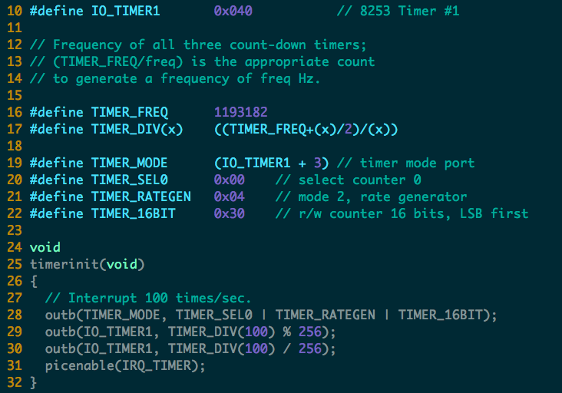

Slide 7
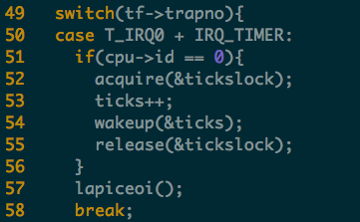
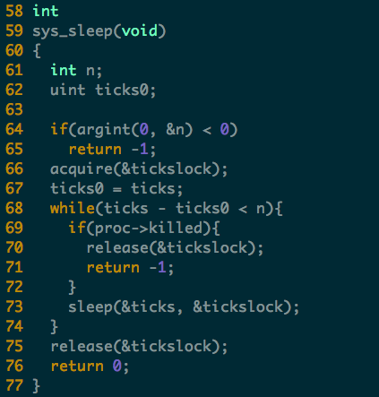
Timer Interrupt

Slide 8
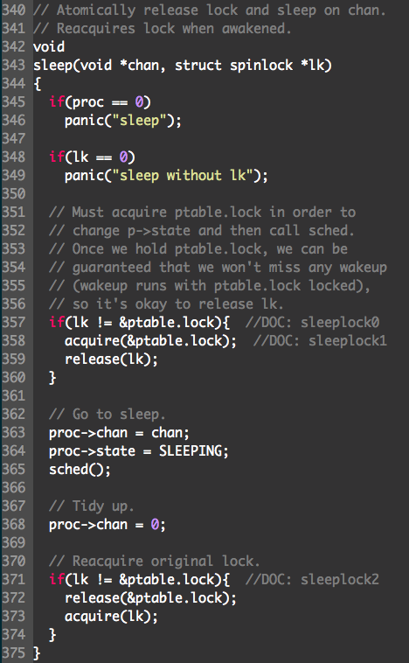
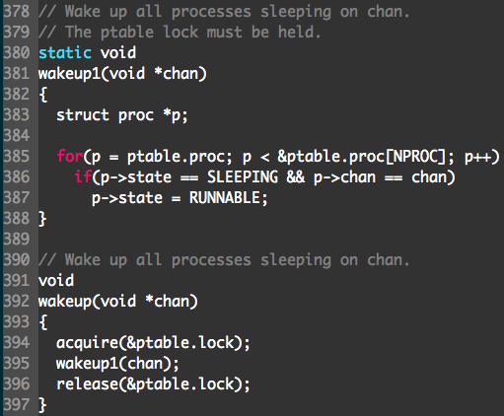
Sleep & Wakeup

Slide 9
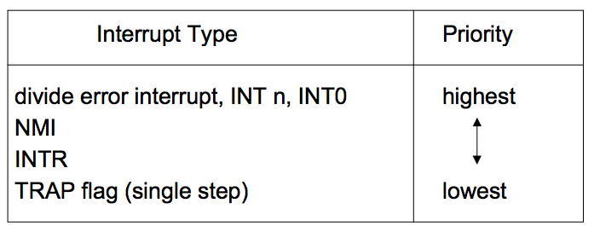
Interrupt Priority
When different types of interrupt (i.e., software, NMI, INTR or exceptions) occur at the same time, the one with the highest priority is handled first
Intel microprocessors use the following order of priority:

Slide 10
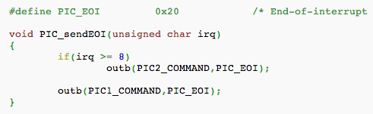
EOI: End of Interrupt
Issued to the PIC chips at the end of an IRQ-based interrupt routine
If the IRQ came from the Master PIC, it is sufficient to issue this command only to the Master PIC;
If the IRQ came from the Slave PIC, it is necessary to issue the command to both PIC chips

Slide 11
Nested Interrupts
What if a second interrupt occurs while an interrupt routine is excuting?
Generally a good thing to permit that — is it possible?
And why is it a good thing?

Slide 12
Maximizing Parallelism
Keep all I/O devices as busy as possible
In general, an I/O interrupt represents the end of an operation
Another request should be issued ASAP
Most devices do not interfere with each others' data structures
No reason to block out other devices

Slide 13
Handling Nested Interrupts
As soon as possible, unmask the global interrupt
As soon as reasonable, re-enable interrupts from that IRQ
But that is not always a great idea, since it could cause re-entry to the same handler
IRQ-specific mask is not enabled during interrupt-handling

Slide 14
Nested Execution
Interrupts can be interrupted
By different interrupts; handlers need not be reentrant
Small portions execute with interrupts disabled
Interrupts remain pending until acked by CPU
Exceptions can be interrupted
By interrupts (devices needing service)
Exceptions can nest two levels deep
Exceptions indicate coding error
Exception code (kernel code) should not have bugs
Page fault is possible (trying to touch user data)

Slide 15
Interrupt Masking
Two different types: global and selective
Global — delays all interrupts
Selective — mask individual IRQs selectively
This is usually what's needed — interference most common from two interrupts of the same type
NMI (Non-Maskable Interrupt)

Slide 16
Triple Fault
Things never to do in an OS #1: Swap out the page swapping code (triple-fault here we come) —Kemp
When a fault occurs, the CPU invokes an exception handler.
If a fault occurs while trying to invoke the exception handler, that's called a double fault, which the CPU tries to handle with yet another exception handler.
If that invocation results in a fault too, the system reboots with a triple fault.
Notes:
A triple fault is usually a sign that the exception handler called is faulty, or worse, that the whole exception handling in your system is screwed up. (LDT or GDT issues, bogus pointers or faulty memory mappings are frequent offenders.)
Another frequent cause of triple faults is a kernel stack overflow. If the stack reaches an invalid page (one with its present bit clear), a page fault is generated. However, the CPU faults while trying to push the exception information on to the stack, so a double fault is generated. The same problem still exists so a triple fault is generated.

Slide 17
/proc/interrupts
$ cat /proc/interrupts
CPU0
0: 865119901 IO-APIC-edge timer
1: 4 IO-APIC-edge keyboard
2: 0 XT-PIC cascade
8: 1 IO-APIC-edge rtc
12: 20 IO-APIC-edge PS/2 Mouse
14: 6532494 IO-APIC-edge ide0
15: 34 IO-APIC-edge ide1
16: 0 IO-APIC-level usb-uhci
19: 0 IO-APIC-level usb-uhci
23: 0 IO-APIC-level ehci-hcd
32: 40 IO-APIC-level ioc0
33: 40 IO-APIC-level ioc1
48: 273306628 IO-APIC-level eth0
NMI: 0
ERR: 0
Columns: IRQ, count, interrupt controller, devices

Slide 18
More in /proc/pci:
$ cat /proc/pci
PCI devices found:
Bus 0, device 0, function 0:
Host bridge: PCI device 8086:2550 (Intel Corp.) (rev 3).
Prefetchable 32 bit memory at 0xe8000000 [0xebffffff].
Bus 0, device 29, function 1:
USB Controller: Intel Corp. 82801DB USB (Hub #2) (rev 2).
IRQ 19.
I/O at 0xd400 [0xd41f].
Bus 0, device 31, function 1:
IDE interface: Intel Corp. 82801DB ICH4 IDE (rev 2).
IRQ 16.
I/O at 0xf000 [0xf00f].
Non-prefetchable 32 bit memory at 0x80000000 [0x800003ff].
Bus 3, device 1, function 0:
Ethernet controller: Broadcom NetXtreme BCM5703X Gigabit Eth (rev 2).
IRQ 48.
Master Capable. Latency=64. Min Gnt=64.
Non-prefetchable 64 bit memory at 0xf7000000 [0xf700ffff].

Slide 19
Bottom half (in Linux)

Slide 20
Interrupt Handling Philosophy
To preserve IRQ order on the same line, must disable incoming interrupts on same line
New interrupts can get lost if controller buffer overflow
Interrupt preempts what CPU was doing, which may be important
Even not important, undesirable to block user program for long
So, handler must run for a very short time!
Do as little as possible in the interrupt handler
Often just: queue a work item and set a flag
Defer non-critical actions till later
Notes:
What disable mean: cpu or PIC not accepting, but device controller can still accept (limited by buffer size)

Slide 21
Intr Handlers Have No Process Context
Interrupts (as opposed to exceptions) are not associated with particular instructions
They are also not associated with a given process (user program)
The currently-running process, at the time of the interrupt, has no relationship whatsoever to that interrupt
Interrupt handlers cannot sleep!

Slide 22
Why No Sleep?
The interrupt handler has no way of knowing what the interrupted process was doing. An example:
Process1 enters kernel mode.
Process1 acquires LockA.
Interrupt occurs.
ISR tries to acquire LockA.
ISR calls sleep to wait for LockA to be released.
At this point, you have a deadlock:
Process1 can't resume execution until the ISR is done with its stack, but the ISR is blocked waiting for Process1 to release LockA
https://stackoverflow.com/questions/1053572/why-kernel-code-thread-executing-in-interrupt-context-cannot-sleep

Slide 23
What Can’t You (ISR) Do?
You cannot sleep
or call something that might sleep
You cannot refer to current
You cannot allocate memory with GPF_KERNEL (which can sleep), you must use GPF_ATOMIC (which can fail)
You cannot call schedule()
You cannot do a down() semaphore call
However, you can do an up()
You cannot transfer data to/from user space
E.g., copy_to_user(), copy_from_user()

Slide 24
Interrupt Stack
When an interrupt occurs, what stack is used?
Exceptions: The kernel stack of the current process, whatever it is, is used (There’s always some process running — the "idle" process, if nothing else)
Interrupts: hard IRQ stack (1 per processor)
SoftIRQs: soft IRQ stack (1 per processor)
These stacks are configured in the IDT and TSS at boot time by the kernel

Slide 25
Top and Bottom Halves
Top-half: do minimum work and return
ISR (Interrupt Service Routine)
Bottom-half: deferred processing
softirqs, tasklets, workqueues, kernel threads
Top half
Bottom half
tasklet
softirq
workqueue
kernel thread

Slide 26
Top Half: Do it Now!
Perform minimal, common functions: saving registers, unmasking other interrupts. Eventually, undoes that: restores registers, returns to previous context.
Most important: call proper interrupt handler provided in device drivers (C program)
Typically queue the request and set a flag for deferred processing
Top half
softirq
Softirq flag = 0
Softirq flag = 1

Slide 27
Bottom Half: Do it Later!
Mechanisms to defer work to later:
softirqs
tasklets (built on top of softirqs)
work queues
kernel threads
All can be interrupted

Slide 28
Softirqs
Statically allocated: specified at kernel compile time
Limited number:
Priority Type
0 High-priority tasklets
1 Timer interrupts
2 Network transmission
3 Network reception
4 Block devices
5 Regular tasklets

Slide 29
When Do Softirqs Run?
Run at various points by the kernel:
After system calls
After exceptions
After interrupts (top halves/IRQs, including the timer intr)
When the scheduler runs ksoftirqd
Softirq routines can be executed simultaneously on multiple CPUs:
Code must be re-entrant
Code must do its own locking as needed
Hardware interrupts are enabled when softirqs run

Slide 30
Rescheduling Softirqs
A softirq routine can reschedule itself
i.e., raise one softirq when handling a softirq
Problem: while processing one softirq, another is raised. Process it?
No -> long delay for new irq
Always -> starve user program when long softirq burst
Livelock!
Solution: Quota + dedicated context ksoftirqd
Softirq scheduler only runs a limited number of requests at a time
The rest are executed by a kernel thread, ksoftirqd, which competes with user processes for CPU time
Ksoftirqd subject to scheduling, as user process
ksoftirqd

Slide 31
Tasklets
Problem: softirq is static
To add a new type of Softirq, need to convince Linus!
Solution: tasklets
Built on top of softirq
New types are created and destroyed dynamically
Simplified for multi-core processing: at any time, only one tasklet among all of the same type can run
Problem with softirq and tasklets
They have no process contexts, thus cannot sleep

Slide 32
Tasklets
Can be created and destroyed dynamically
Run on the CPU that scheduled it (cache affinity)
Individual tasklets are locked during execution
no problem about re-entrancy
no need for locking by the code
Tasklets can run in parallel on multiple CPUs
Same tasklet can only run on one CPU
Were once the preferred mechanism for most deferred activity, now changing

Slide 33
The Trouble with Tasklets
Hard to get right
One has to be careful about sleeping
Run at higher priority than other tasks
Can produce uncontrolled latency if coded badly
Ongoing discussion about eliminating tasklets
Will likely slowly fade over time

Slide 34
Work Queues
Softirqs and tasklets run in an interrupt context; work queues have a process context
The idea:
You throw work (fn, args) to a workqueue
Workqueue add to an internal FIFO queue
A dedicated workqueue process loops forever, dequeuing (fn, args), and running fn(args)
Since they have a process context, they can sleep
They are kernel-only; no user mode associated with it
Do not try copying data into/out of user space
Notes:
To create a workqueue, call creat_workqueue("name")
The add a deferred task, call queue_work(), which will add a work item (fn, args) to a queue
Kernel will create a thread, looping forever (until workqueue destroyed). Each iteration will dequeue (fn, args), and run fn on args.

Slide 35
Kernel Threads
Always operate in kernel mode
Again, no user context
2.6.30 introduced the notion of threaded interrupt handlers
Imported from the realtime tree
request_threaded_irq()
Now each bottom half has its own context, unlike work queues
Idea is to eventually replace tasklets and work queues

Slide 36
Comparing Approaches
 | ISR | SoftIRQ | Tasklet | WorkQueue | KThread
Will disable all interrupts? | Briefly | No | No | No | No
Will disable other instances of self? | Yes | Yes | No | No | No
Higher priority than regular scheduled tasks? | Yes | Yes* | Yes* | No | No
Will be run on same processor as ISR? | N/A | Yes | Yes | Yes | Maybe
More than one run can on same CPU? | No | No | No | Yes | Yes
Same one can run on multiple CPUs? | Yes | Yes | No | Yes | Yes
Full context switch? | No | No | No | Yes | Yes
Can sleep? (Has own kernel stack) | No | No | No | Yes | Yes
Can access user space? | No | No | No | No | No
*Within limits, can be run by ksoftirqd

